Slide 1
Dialysis of Patients

Slide 2


OUR TEAM (GROUP 1)
SINCHAL GAJBHIYE
KIRTI UPADHYAY TIWARI
SHRUTI SHETH
SHRAVAN KUMAR

Slide 3
TABLE OF CONTENTS
1
KPI 1 Number of Patients across various summaries
2
KPI 2 Profit Vs Non-Profit Stats
01
ALL KPI ANALYSIS & RECOMMENDATION
3
KPI 3 Chain Organizations w.r.t. Total Performance Score as No Score
4
KPI 4 Dialysis Stations Stats
5
KPI 5 Total Category Text - As Expected
6
KPI 6 Average Payment Reduction Rate
02
Dashboard and Screenshot
1
Excel Dashboard
2
Power Bi Dashboard
3
Tableau Dashboard

Slide 4
01
ALL KPI ANALYSIS & RECOMMENDATIONS

Slide 5
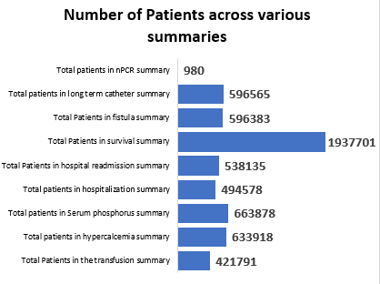
KPI 1 Number of Patients across various summaries
The number of patients in different summaries helps tracking the patient population trends, such as the total number of patients, patient demographics, and specific patient summaries (e.g., by age, gender, or medical conditions).
This KPI insights can be used to analyse demand for dialysis services.
It helps in the capacity planning, and thus assists healthcare providers in delivering personalized care based on patient characteristics.
According to severity on the basis of summaries the patient outcomes can be defined.
Analysis
Recommendations

Slide 6
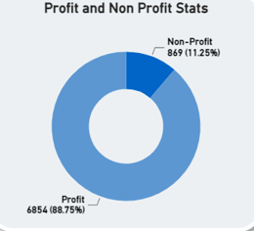
KPI 2 Profit Vs Non-Profit Stats
This analysis involves examining key financial metrics, such as revenue, expenses, profit margins, and return on investment, to understand the economic landscape of the dialysis care sector.
This analysis can help to find differences in financial outcomes of profit and non-profit organizations and enables stakeholders to make informed decisions regarding sustainability of care, cost management, and resource allocation.
Analysis
Recommendations

Slide 7
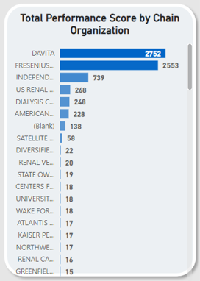
KPI 3 Chain Organizations w.r.t. Total Performance Score as No Score
The total performance score depicts efficiency through various quality measures, patient outcomes, and adherence to best practices.
The total performance score with respect to chain organizations helps healthcare providers to identify areas of improvement, benchmark against industry standards, and promote quality care delivery across different chains.
Analysis
Recommendations

Slide 8
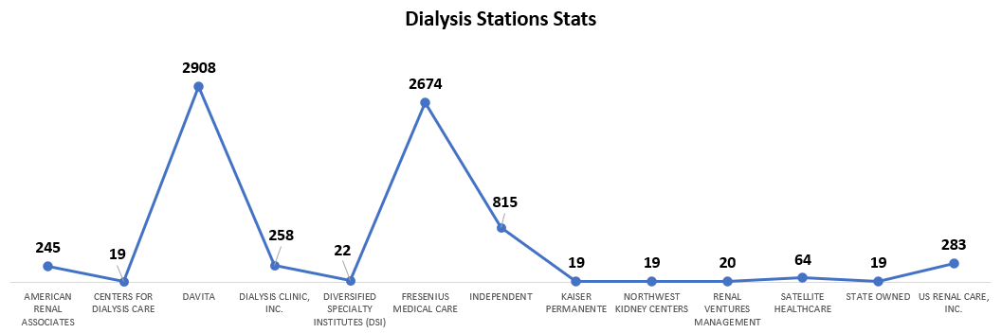
KPI 4 Dialysis Stations Stats
The ratings of dialysis centre can be used to compare dialysis facilities (centers) based on the quality of patient care they provide. This can be used to compare their patient experience survey results.
This KPI helps to analyse number of dialysis stations, their utilization rates, availability, and efficiency of operations.
By these statistics, healthcare providers can optimize:
Areas of underutilization or overcrowding identification.
Equitable access to dialysis services
Improve operational efficiency in delivering care
Resource allocation
Analysis
Recommendations

Slide 9
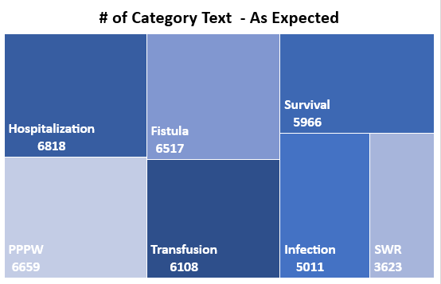
KPI 5 Total Category Text - As Expected
This categorizing of patients maintains specific criteria which helps examining their outcomes.
This analysis helps hospitals to prioritize the services provided to the patients on the basis of category alloted.
These outcomes when compared with expectations can help healthcare providers assess the effectiveness of different treatment plans, identify patterns, and tailor care strategies to specific patient categories, ultimately improving the quality of care provided.
Analysis
Recommendations

Slide 10
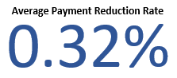
KPI 6 Average Payment Reduction Rate
This KPI helps to identify reimbursements, contractual agreements and insurance related statistics.
The hospitals and healthcare providers can analyze their financial status and plan strategies for their revenue.
This KPI can help to decide the costs of dialysis which vary widely according to many factors and conditions.
This can help to regulate the additional costs with dialysis e.g physician fees, diagnostics, medicines and hospitalizations.
On this basis hospitalization costs and total expenditures for dialysis patients can be fixed.
Analysis
Recommendations

Slide 11
02
DASHBOARDS
OR SCREENSHOTS

Slide 12
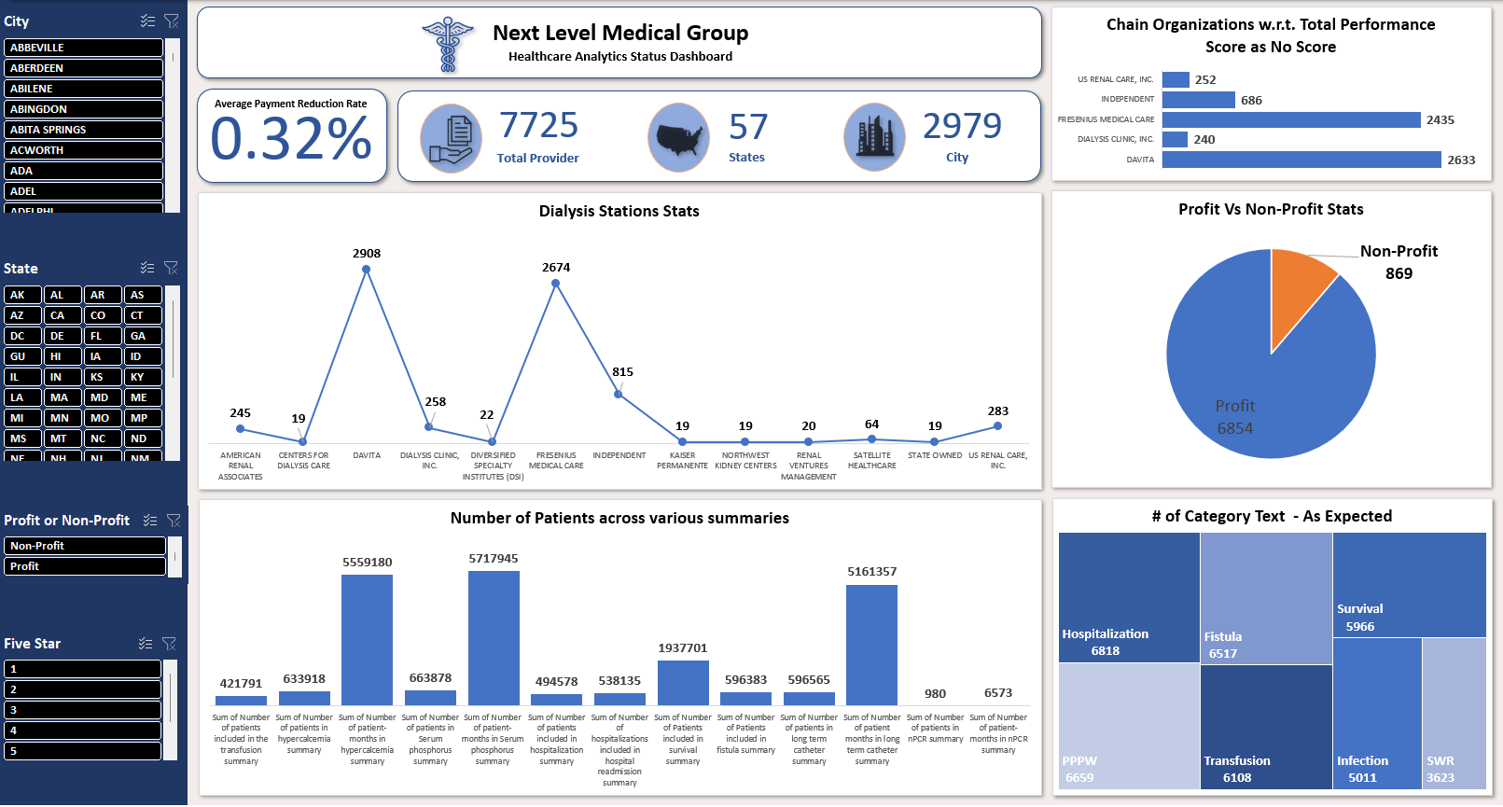
Excel Dashboard

Slide 13
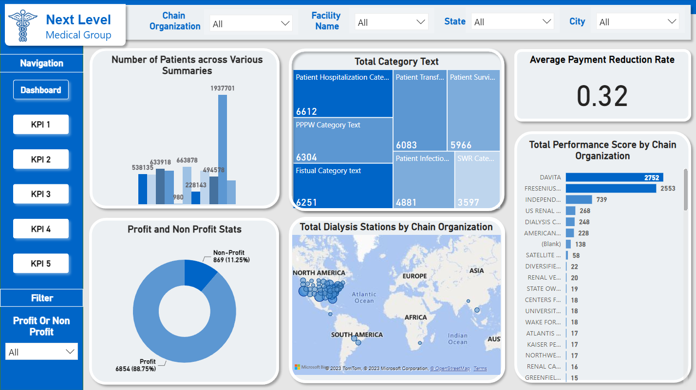
Power Bi Dashboard

Slide 14
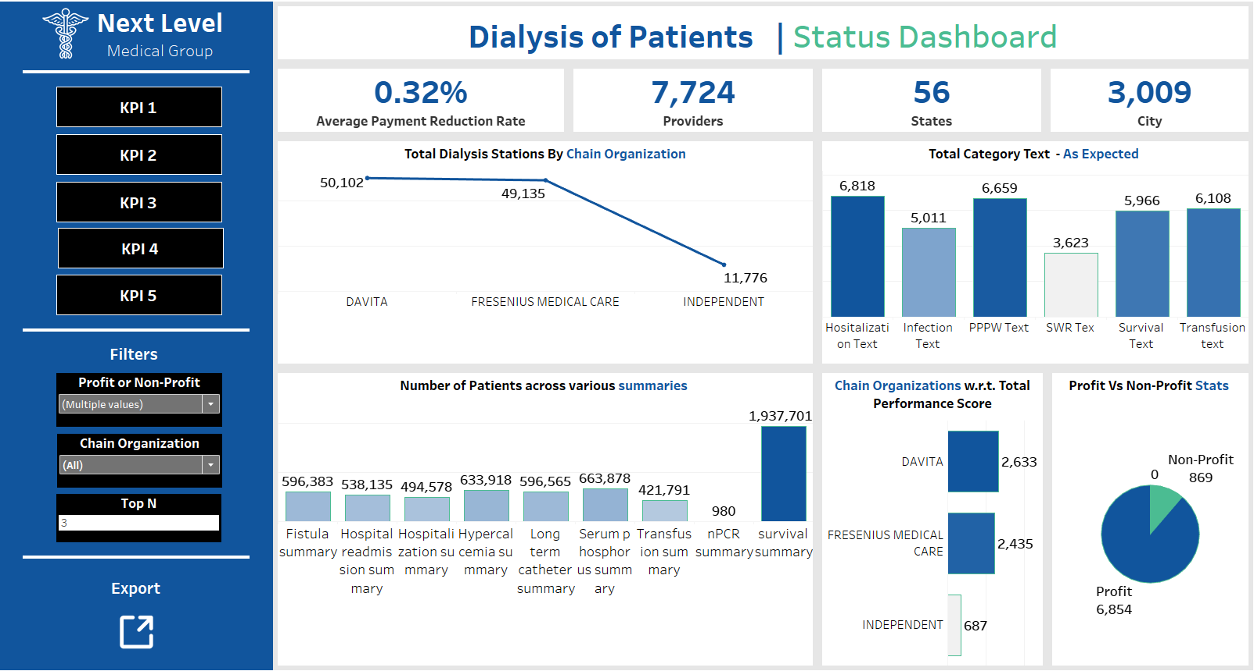
Tableau Dashboard

Slide 15
THANK
YOU!
Do you have any questions?

